Slide 1
Weekly Update #23
Gijs Admiraal

Slide 2
This week?
Looked at the implementation of OADM
Specifically, are sequences generated token by token?
Finished datasets
Started training both representations
Started writing methodology/background
Worked on evaluation

Slide 3
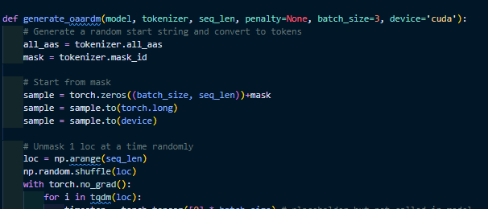
OADM
OADM is able to attain similar results as D3PM-absorbing but with fewer steps
From evodiff code they generate sequences tokens one by one
Thus, for long sequences (>T) we will need more steps
Easier to change the transition matrix to absorbing then to implement the dynamic programming for OADM part
I will stick with the D3PM framework

Slide 4
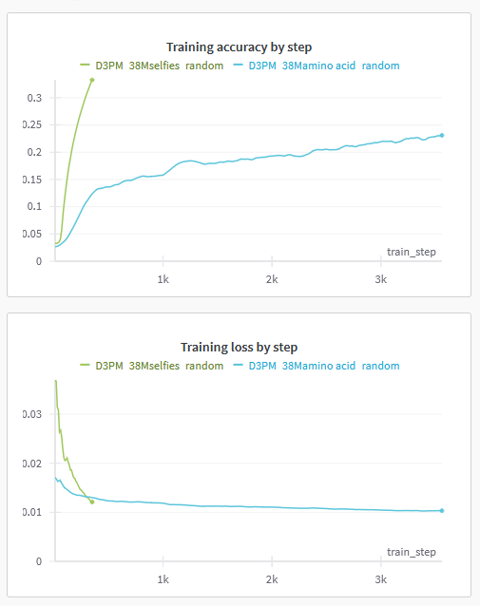
Datasets and training
Created on big H5 training file with training/validation and representation split
Training seems to go really well…
Distribution of selfies tokens concentrated at token [C]
Model likely predicts token [C] often
Interesting to see
if/when curves plateaus
performance of generated sequences

Slide 5
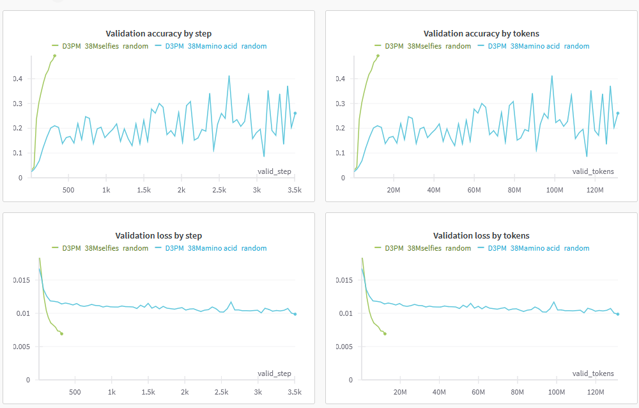
Validation

Slide 6
Evaluation
Validating true protein from SELFIES
BLAST analysis on sequences
SCOP classification
AlphaFold/OmegaFold validation
Inpainting experiments
Exploratory experiments
Data augmentation
Finetune for unnatural protein generation

Slide 7
Next week?
Finish masking transition matrix for D3PM
Start evaluating sequences after initial training finishes
Plot distribution of SELFIES tokens
Continue training
Continue writing

Slide 8
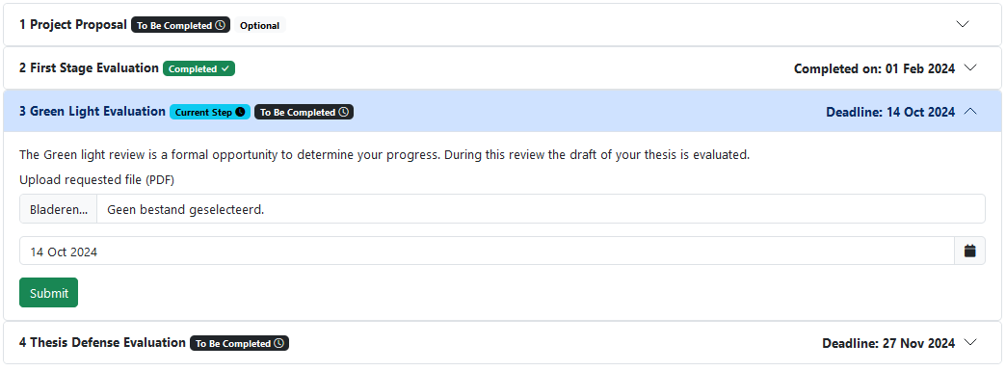
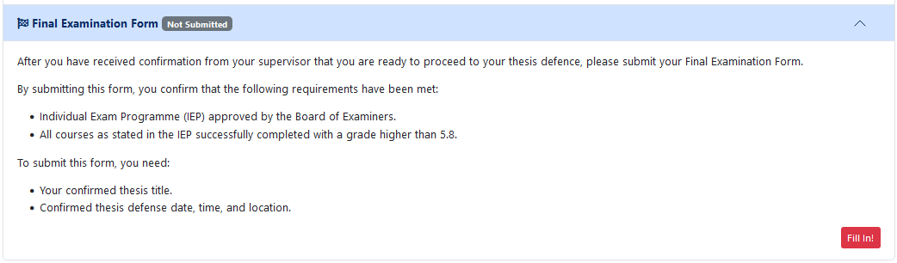
MaRe

Slide 9
Notes

